Slide 1
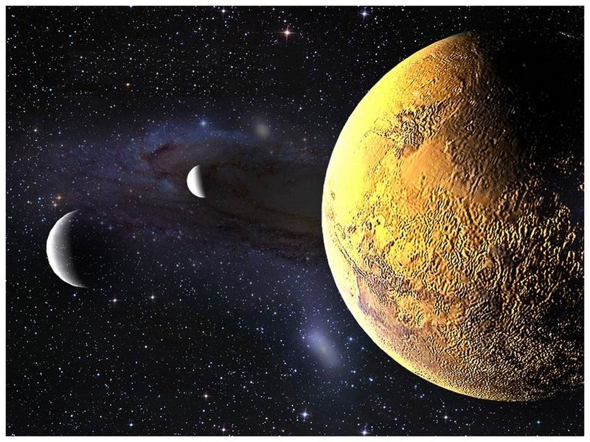
S.O.L.I.D.
Liskov Substitution and Interface Segregation Principles

Slide 2
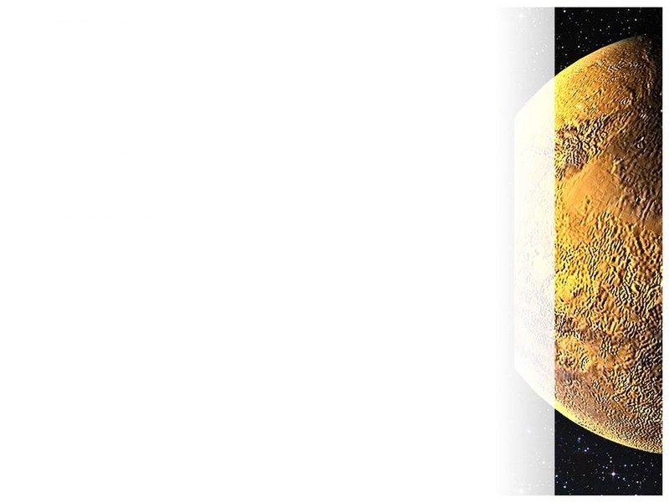
What is Liskov Substitution?
Wikipedia: if S is a subtype of T, then objects of type T may be replaced (substituted) with objects of type S without altering any of the desirable properties of the software (correctness, task performed, etc.)
Strong behavioral subtyping
Semantic as well as syntactic
Notes:
Can pretty much ignore the long definition

Slide 3
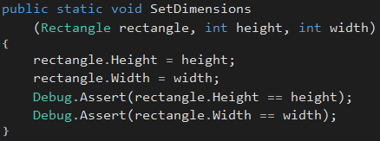
A Violation Example…
Rectangle
int Width
int Height
Square
int Width
int Height
What is wrong with this picture?

Slide 4
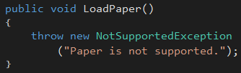
Violation Example #2
Printer
void Print
void LoadPaper
void EjectedPrintedOutput
bool IsReady
InkJetPrinter
LaserPrinter
3DPrinter
LoadPaper?
Notes:
Example of trying to use a common base type, even when all sub types don’t semantically adhere to it.
If you find yourself throwing NotSupportedExceptions, you are probably violating Liskov.

Slide 5

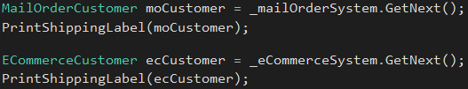

Violation Example #3
ICustomer
int Id
string Address
string City
string State
string Zip
MailOrderCustomer
…
Subscription CatalogSubscription
ECommerceCustomer
…
string UserName
string PasswordHash
Notes:
This is an example where a property is used one way in one context, and another way in another context.
Commonly done, but violates Liskov.
Methods only work when used in certain contexts.

Slide 6
What is Interface Segregation?
Wikipedia: no client should be forced to depend on methods it does not use. ISP splits interfaces which are very large into smaller and more specific ones so that clients will only have to know about the methods that are of interest to them.
Role interfaces
Encourages more broadly applicable interfaces

Slide 7

Liskov Violation Example Revisited
IGeoAddressable
ICustomer
MailOrderCustomer
ECommerceCustomer
Employee
Saved by Interface Segregation!

Slide 8
Can you spot all the modeling mistakes?
Bird
void TakeOff
void Land
Sparrow
Ostrich
Penguin
Fish
void Propel
float MaxDepth
FlyingFish
Minnow
StarFish
Notes:
-Ostrich and Penguin can’t fly
-FlyingFish also flies
-StarFish doesn’t swim (ignore that it is not a fish!)
-Penguin

Slide 9
Improved Model
ISwimmable
Bird
IFlyable
Ostrich
Penguin
Fish
Trout
StarFish
Sparrow
FlyingFish
Notes:
Now, code that controls flight is only concerned about members related to flight.
Code that controls swimming doesn’t have to deal with the noise of non-swim related members.
Liskov can be at play now; code related to flight can work regardless of actual type.
Room for improvement; since fish almost always swim, abstract base class SwimmingFish can be introduced

Slide 10
Single Inheritance Languages
Word of caution: Base implementation for multiple interfaces cannot all be inherited
Principle originated in C++, where multiple inheritance is allowed
Dynamic languages can support, or simulate, multiple inheritance
Avoid overly “fat” interfaces
Make good use of helper classes
ISwimmable
BaseFlyable
IFlyable
BaseSwimmable
FlyingFish

Slide 11
Exercise – Aliens Discovered!
Right-click to add aliens to the map, left-click to add standard obstacles
Rover cannot move through aliens, and aliens cannot move through aliens
HINT: Aliens are obstacles
Aliens can be destroyed by missiles and mortars (they are destructible)
Aliens move on each rover command
Aliens move in the exact same way as the rover, only randomly
Forward, Backward, and turning Left or Right

Slide 12
Exercise – Aliens Discovered!
Right-click to add aliens to the map, left-click to add standard obstacles
Rover cannot move through aliens, and aliens cannot move through aliens
HINT: Aliens are obstacles
Aliens can be destroyed by missiles and mortars (they are destructible)
Aliens move on each rover command
Aliens move in the exact same way as the rover, only randomly
Forward, Backward, and turning Left or Right
Instructions
Open Solution/MarsCommander.sln and work in MarsRoverKata project
Alien implements the newly introduced IObstacle (Done for you to satisfy the compiler). Implement the members.
Cut movement related members of Rover to abstract base type Movable
Extract IMovable interface from Movable class (see code comments)
Make Rover inherit Movable
Make Alien inherit Movable
Open AlienBehavior and un-comment the code (NOTE: This is the logic that controls alien movement)
Resolve the build errors
BONUS: How might you prevent Rover instances from moving into each other? 30 Minutes

Slide 13
Exercise – Possible Solution
IMovable
Obstacle
IObstacle
Movable
Rover
Alien
Crater

Slide 14
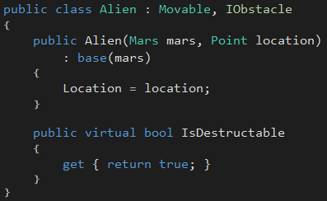
Exercise – Aliens Implementation

Slide 15

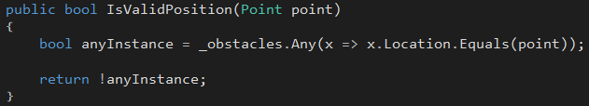
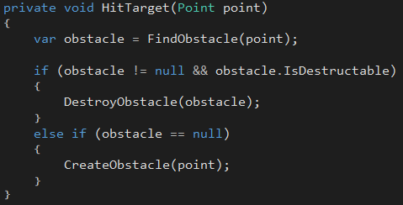
Exercise – Aliens Implementation
LSP:
Aliens are substitutable for Obstacle or Crater
ISP:
Obstacle-detection code knows about minimal interface necessary
Any type can “become” an obstacle

Slide 16
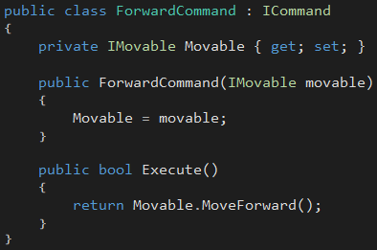


Exercise – Movement Explained
LSP:
Rover and Alien can both be substituted in for any IMovable
ISP:
Movement commands only know about movement-related methods
Any type can take on the characteristics of being “movable”

